Slide 1
COMP90007 Internet Technologies Workshop
Week 3

Slide 2
Slides
https://github.com/SiaHuo/COMP90007Workshops
If there is any error in slides, please point it out.
Please refer to solution on LMS for standard answers

Slide 3
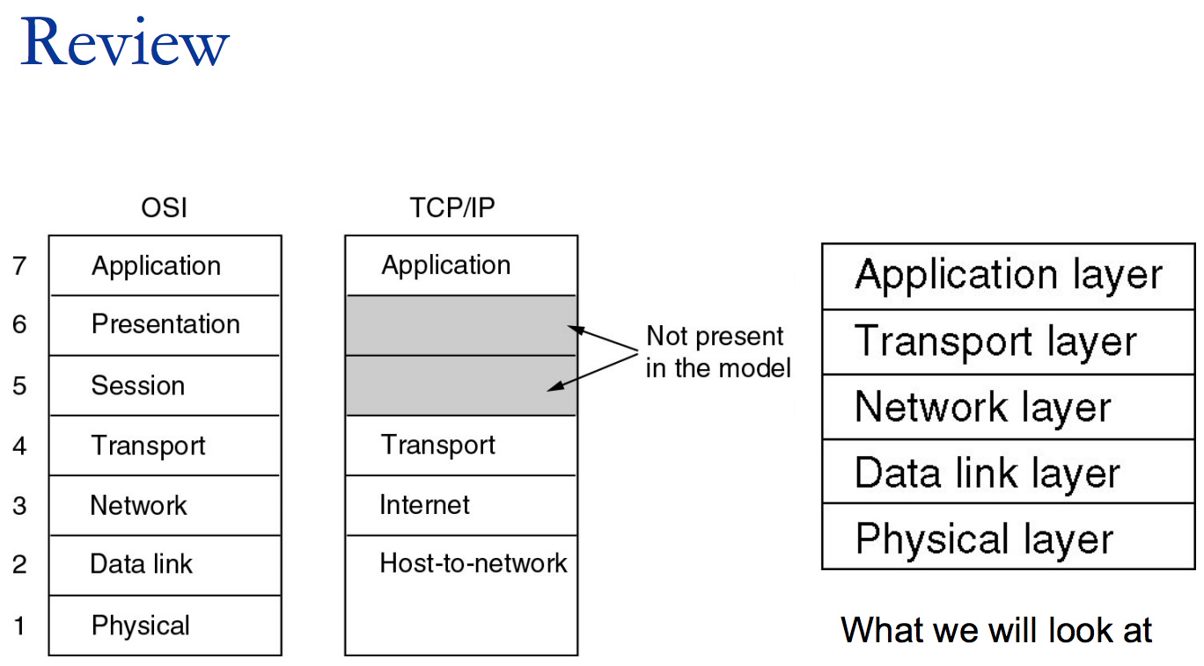
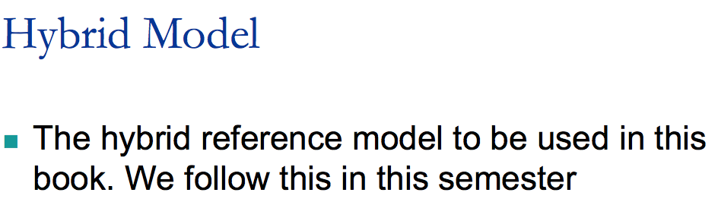

Slide 4
Question 1 (Layers)
Identify 2 ways in which the OSI reference model and the TCP/IP reference model are the same.
Identify 2 ways in which these models differ.
(NB: You can use the textbook to solve this question)
Similarities:
stacking of layered protocols
similar functionality in each of the layers
layers above transport layer relate to applications
Differences:
TCP/IP does not distinguish between services, interfaces and protocols
TCP/IP does not clearly separate physical and data link functions
OSI supports connectionless and connection-oriented communication at the network layer, while TCP/IP supports only connectionless communication at the IP layer
OSI supports only connection-oriented communication at the transport layer, while TCP/IP supports both connection-oriented and connectionless communication at the transport layer
Notes:
The OSI and TCP/IP reference models have much in common. Both are based on the concept of a stack of independent protocols. Also, the functionality of the layers is roughly similar.
Despite these fundamental similarities, the two models also have many differences:
Three concepts are central to the OSI model: 1. Services. 2. Interfaces. 3. Protocols. Probably the biggest contribution of the OSI model is that it makes the distinction between these three concepts explicit.
Each layer performs some services for the layer above it. The service definition tells what the layer does.
A layer’s interface tells the processes above it how to access it.
Finally, the peer protocols used in a layer are the layer’s own business. It can use any protocols it wants to, as long as it gets the job done (i.e., provides the offered services). It can also change them at will without affecting software in higher layers.

Slide 5
Question 1 (Layers)
Identify 2 ways in which the OSI reference model and the TCP/IP reference model are the same.
Identify 2 ways in which these models differ.
(NB: You can use the textbook to solve this question)
Similarities:
stacking of layered protocols
similar functionality in each of the layers
layers above transport layer relate to applications
Differences:
TCP/IP does not distinguish between services, interfaces and protocols
TCP/IP does not clearly separate physical and data link functions
OSI supports connectionless and connection-oriented communication at the network layer, while TCP/IP supports only connectionless communication at the IP layer
OSI supports only connection-oriented communication at the transport layer, while TCP/IP supports both connection-oriented and connectionless communication at the transport layer
Notes:
Another difference is in the area of connectionless versus connection-oriented communication. The OSI model supports both connectionless and connection- oriented communication in the network layer, but only connection-oriented com- munication in the transport layer, where it counts (because the transport service is visible to the users). The TCP/IP model supports only one mode in the network layer (connectionless) but both in the transport layer, giving the users a choice. This choice is especially important for simple request-response protocols.

Slide 6
Question 2 (Delay and bandwidth)
Calculate the end-to-end transit time for a packet for
GEO (Geostationary orbit) (altitude: 35,800 km),
MEO (Medium Earth orbit) (altitude: 18,000 km) and
LEO (Low Earth orbit) (altitude: 750 km) satellites.
Transit time = 2 × distance / speed of light,
where speed of light c = 3.0×10⁸ m/s
GEO: (2 * 35800 km) / (3.0×10⁸ m/s ) = 239 ms
MEO: 120 ms
LEO: 5 ms
Notes:
Divide by
Satellites are effective for broadcast distribution and anywhere/anytime communications
Kinds of Satellites

Slide 7
Question 3 (Delay and bandwidth)
An image is 1600 × 1200 pixels with 3 bytes/pixel. Assume the image is uncompressed.
How long does it take to transmit it over a 56-kbps modem channel, assuming zero propagation delay over the channel?
Over a 1-Mbps cable modem? Over a 10-Mbps Ethernet?
Over 100-Mbps Ethernet? Over gigabit Ethernet?
Image size = 1600 × 1200 × 3 × 8 = 46.08 ×10⁶ bits
Over 56 kbps modem channel:
46.08 ×10⁶ bits / 56 kbps = 823 s
Over 1 Mbps cable modem：
46.08 ×10⁶ bits / 1 Mbps = 46.1s
10 Mbps：4.6s
100 Mbps： 0.46s
1 Gbps： 0.046s
Hints：
1 byte = 8 bits
1 kbps = 1000 bit per second
1 Mbps = 10⁶ bit per second
1 gigabit = 10⁹ bit per second

Slide 8
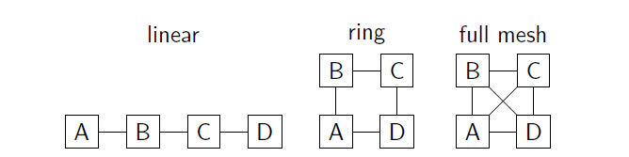
Question 4 (Topology)
Consider the following 3 network topologies for connecting N nodes. In the general case of an N node network:
(a) How many links are there in each network?
Linear: N − 1 links Ring: N links Full mesh: N(N − 1)/2 links
(b) What is the maximum delay between any pair of nodes, assuming each link has a delay of 10ms, and the shortest path is used between nodes?
Linear: 10(N − 1) ms Ring: 10*N/2 ms Full mesh: 10 ms
(c) What is the minimum number of links that need to be cut in order to isolate one or more nodes?
Linear: 1 link Ring: 2 links Full mesh: N − 1 links
(d) Which topology would you use to connect military command centres?
Full mesh – cost not important, but reliability is essential

Slide 9
Question 5 (Topology)
Is an oil pipe a simplex system, a half-duplex system, a full duplex system or none of the above? Under which conditions?

Slide 10
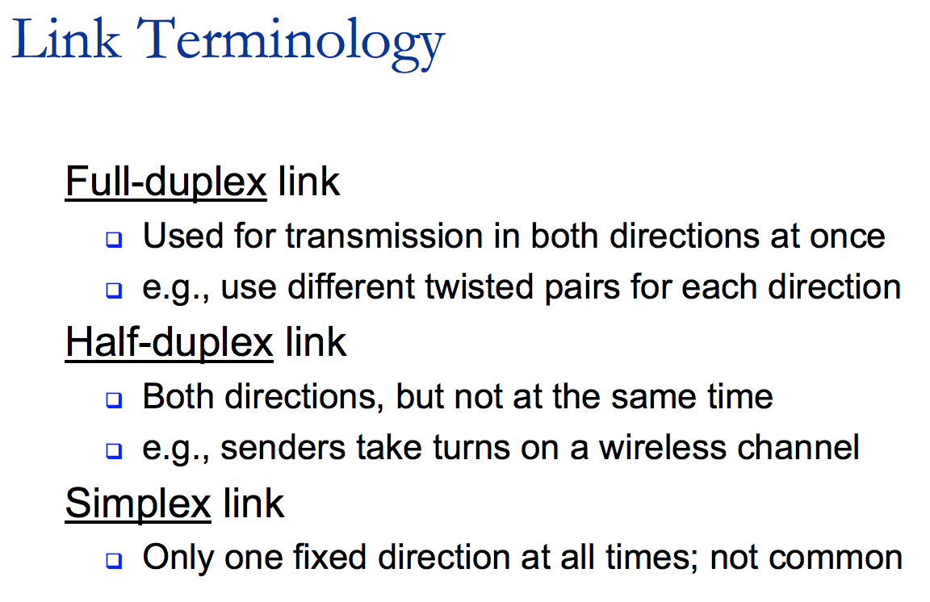

Slide 11
Question 5 (Topology)
Is an oil pipe a simplex system, a half-duplex system, a full duplex system or none of the above? Under which conditions?
Oil can flow in either direction, but not both ways at once, therefore it cannot be full duplex.
Depending on the situation, at an oil refinery, for example, an oil pipe is simplex, as the oil only flows in one direction.
Theoretically oil can flow both ways, therefore it can be consider half duplex, similar to a single railroad track.

Slide 12
Question 6 (Sampling)
Consider a telephone signal that is bandwidth limited to 4 kHz.
(a) At what rate should you sample the signal so that you can completely reconstruct the signal?
(b) If each sample of the signal is to be encoded at 256 levels, how many bits/symbol are required for each sample?
(c) What is the minimum bit rate required to transmit this signal?

Slide 13
Nyquist’s theorem
sampling …...
Analog signal
digital values
digital modulation
Notes:
With the on-going of time, the need arose to turn the analog signals into a series of ones and zeroes. It was time for digital.
Why? Switching to digital increased the transmission capacity of networks.
Sampling is the key technique used to digitize analog information such as sound, photographs, and images.
And, This theorem was the key to digitizing the analog signal.

Slide 14
Nyquist’s theorem
sampling …...
Analog signal
digital values
digital modulation
Notes:
Digital modulation：Wires and wire- less channels carry analog signals such as continuously varying voltage, light intensity, or sound intensity. To send digital information, we must devise analog signals to represent bits. The process of converting between bits and signals that represent them is called digital modulation.

Slide 15
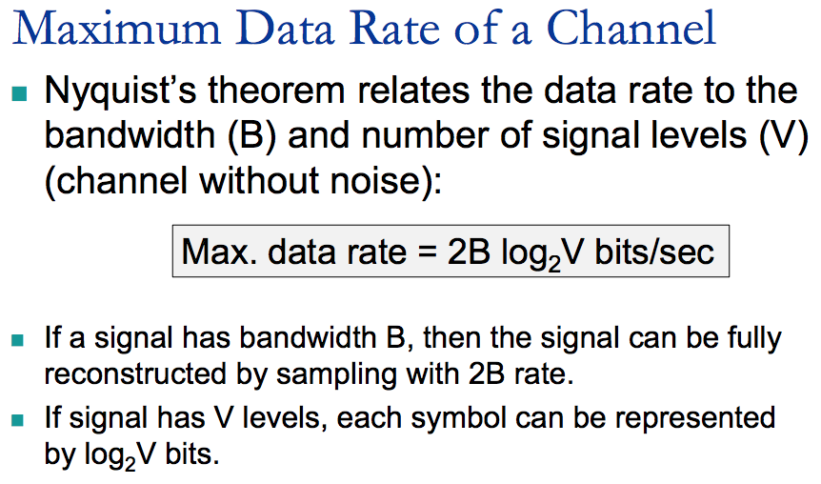
Nyquist’s theorem
Notes:
To explain Nyquist's theorem a bit more: in its most basic form, Nyquist’s work states that an analog signal waveform can be converted into digital by sampling the analog signal at equal time intervals.
The sampling rate must be “equal to, or greater than, twice the highest frequency component in the analog signal.”
Bit has 2 states: 0 or 1. SO if we have 4bits, we can use 4 bits to represent 16 level. (The fourth power of 2 is 16)

Slide 16
Nyquist’s theorem
Notes:
Nyquist, realized that even a perfect channel has a finite transmission capacity. He derived an equation expressing the maximum data rate for a finite-bandwidth noiseless channel.
We will just briefly summarize their now classical results here.
Nyquist proved that if an arbitrary signal has been run through a low-pass filter of bandwidth B, the filtered signal can be completely reconstructed by making only 2B (exact) samples per second.
For example, a noiseless 3-kHz channel cannot transmit binary (i.e., two-level) signals at a rate exceeding 6000 bps.

Slide 17
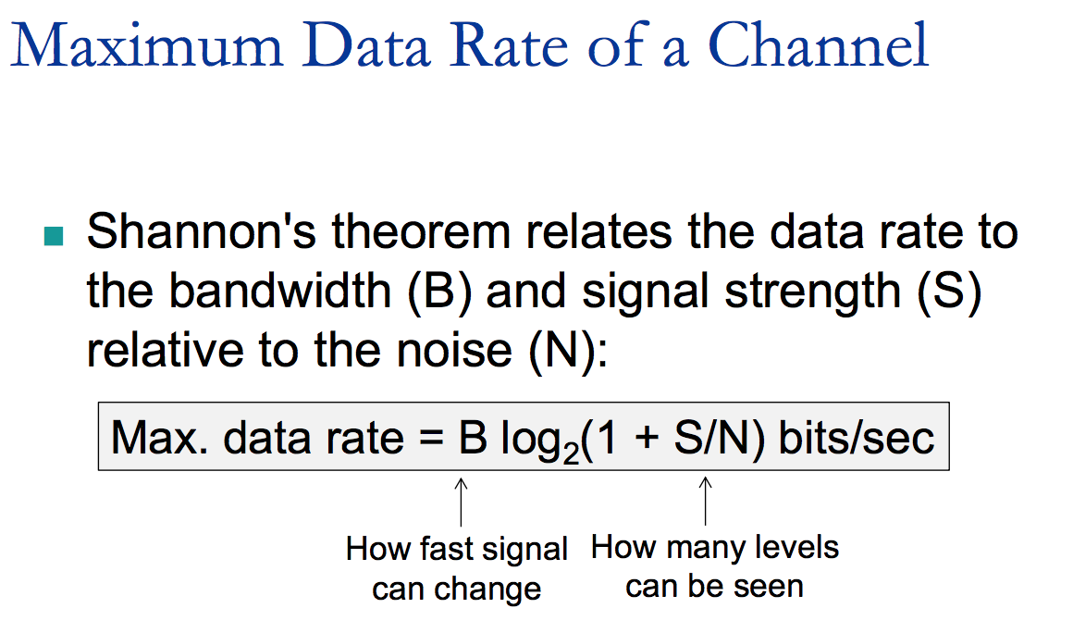
Shannon’s theorem
Notes:
Shannon carried Nyquist’s work further and extended it to the case of a channel subject to random noise (that is, thermodynamic)
This tells us the best capacities that real channels can have.

Slide 18
Question 6 (Sampling)
Consider a telephone signal that is bandwidth limited to 4 kHz.
(a) At what rate should you sample the signal so that you can completely reconstruct the signal?
By Nyquist’s Theorem: min. sampling rate = 2 × 4000 = 8 kHz = 8000 samples/s
(b) If each sample of the signal is to be encoded at 256 levels, how many bits are required for each sample?
256 possible values per sample requires log₂(256) = 8 bits/sample
(c) What is the minimum bit rate required to transmit this signal?
8 bits/sample × 8000 samples/s = 64 kbps
Notes:
b. V = 256 means 256 levels. How many bits do we need to represent 256 level. Log2 256 = 8

Slide 19
Question 7 (Sampling)
Is the Nyquist theorem true for optical fibre or only for copper wire?
The Nyquist theorem is a property of mathematics and has nothing to do with technology.
The Nyquist theorem is independent of the transmission medium.

Slide 20
Question 8 (Sampling)
A noiseless 4 kHz channel is sampled every 1 ms. What is the maximum data rate of the communications channel?
A noiseless channel can carry an arbitrarily large amount of information, no matter how often it is sampled. (i.e. there can be an infinite number of signalling levels because there is no noise)
Just send a lot of data per sample. Assume a 4 kHz channel, sampled at 8 kHz. If each sample is 16 bits, the channel can send 128 kbps. If each sample is 1024 bits, the channel can send 8.2 Mbps.
The key word here is “noiseless.” With a normal noisy 4 kHz channel, Shannon specifies a limit on the information rate on the channel known as its capacity.
Notes:
Assume the channel is a road. The bandwidth is 4 kHz, so sampled with 8kHz. We assume that each sample is a ball. 8000samples/s
Then what does level mean? There are many levels, and each sample behave as one of the levels.
We have mentioned that, if we want to represent 16 levels, how many bits do we need? 4. Because the fourth power of 2 is 16.
Noiseless is the key word here, Why? if the channel is noiseless, which means we can see infinite number of levels.
For this question, it didn’t specify the value of levels. SO if the level is infinite, then …
Sample rate: samples/s
signal level: V bits/sample

Slide 21
Question 9 (Sampling)
The bandwidth of a television video stream is 6 MHz. How many bits/sec are sent if four-level digital signals are used? Assume a noiseless channel.
Using the Nyquist theorem, we should sample at 12 MHz or 12 million times/s.
Four levels of signalling provide:
log₂ 4 = 2 bits/sample
Hence, the total data rate is:
12 million samples/s × 2 bits/sample = 24 Mbps.

Slide 22
Question 10 (Sampling)
Radio antennas often work best when the diameter of the antenna is equal to the wavelength of the radio wave. Reasonable antennas range from 1 cm to 5 meters in diameter. What frequency range does this cover?
λf = c, where c = 3.0×10⁸ m/s
For λ = 0.01 m, f = 30×10⁹ Hz
For λ = 5 m, f = 60×10⁶ Hz
Thus, the band covered is 60 MHz to 30 GHz.

Slide 23
Question 11 (Modulation)
Ten signals of bandwidth 4 kHz, are multiplexed onto a single channel using FDM (frequency division multiplexing). What is the minimum bandwidth required for the multiplexed channel? Assume that guard bands of 400 Hz are used.

Slide 24
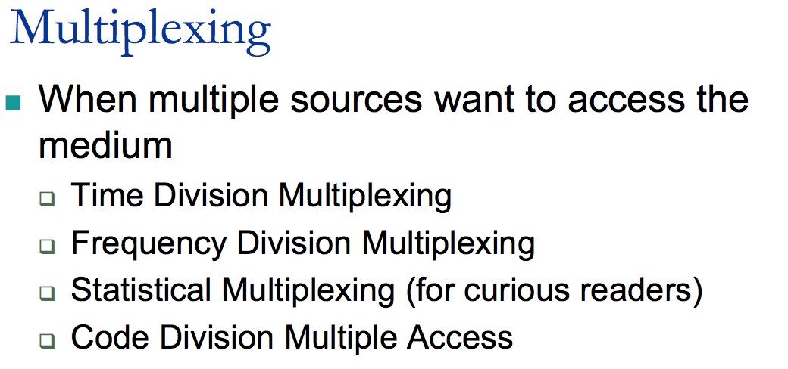
Notes:
Channels are often shared by multiple signals. After all, it is much more convenient to use a single wire to carry several signals than to install a wire for every signal. This kind of sharing is called multiplexing. It can be accomplished in several different ways. We will present methods for time, frequency, and code di- vision multiplexing.

Slide 25
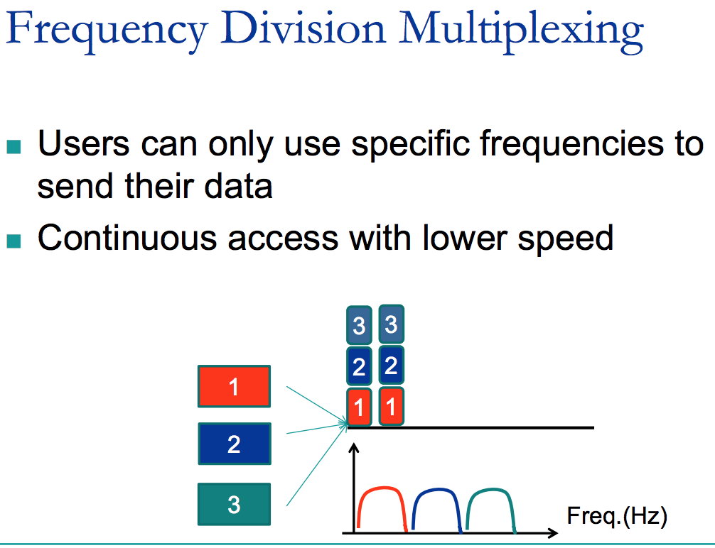
Notes:
It divides the spectrum into frequency bands, with each user having exclusive possession of some band in which to send their signal.
For a more detailed example, in Fig. 2-25 we show three voice-grade telephone channels multiplexed using FDM. Filters limit the usable bandwidth to about 3100 Hz per voice-grade channel. When many channels are multiplexed together, 4000 Hz is allocated per channel. The excess is called a guard band. It keeps the channels well separated.

Slide 26
Question 11 (Modulation)
Ten signals of bandwidth 4 kHz, are multiplexed onto a single channel using FDM (frequency division multiplexing). What is the minimum bandwidth required for the multiplexed channel? Assume that guard bands of 400 Hz are used.
There are ten signals of 4 kHz. Nine guard bands are required in between the modulated bandpass signals to avoid interference when demultiplexing.
Therefore the minimum bandwidth required of the channel is: (4000 × 10) + (400 × 9) = 43.6 kHz.

Slide 27
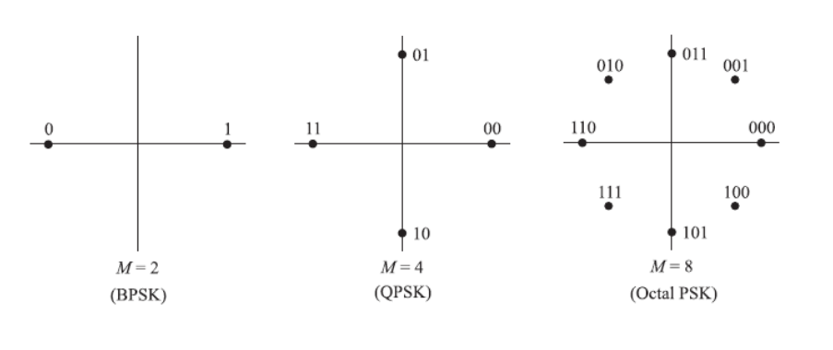
Question 12 (Modulation)
In a constellation diagram, all points lie on a circle centred on the origin. What kind of modulation is being used?
Binary phase-shift keying
Quadrature phase-shift keying

Slide 28
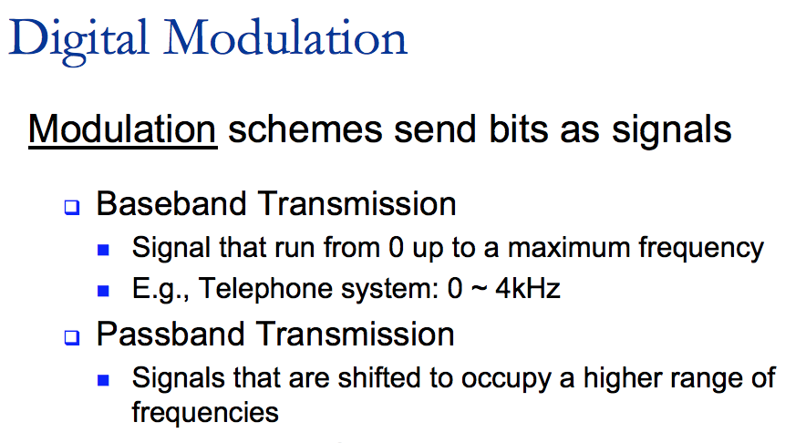
Notes:
Now we talk about sending digital information.
We will start with schemes that directly convert bits into a signal. These schemes result in baseband transmission, in which the signal occupies frequen- cies from zero up to a maximum that depends on the signaling rate. It is common for wires. Then we will consider schemes that regulate the amplitude, phase, or frequency of a carrier signal to convey bits. These schemes result in passband transmission, in which the signal occupies a band of frequencies around the fre- quency of the carrier signal. It is common for wireless and optical channels for which the signals must reside in a given frequency band.

Slide 29
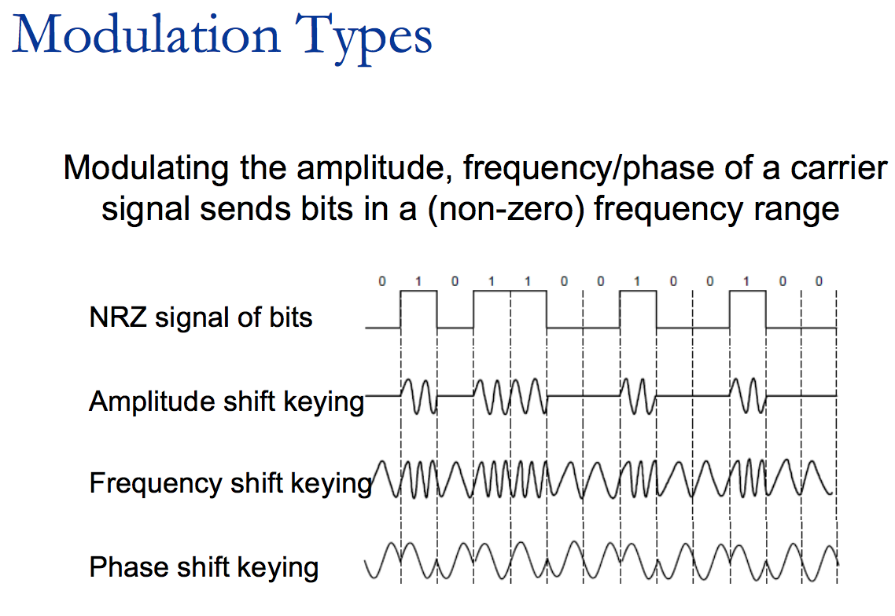

Slide 30
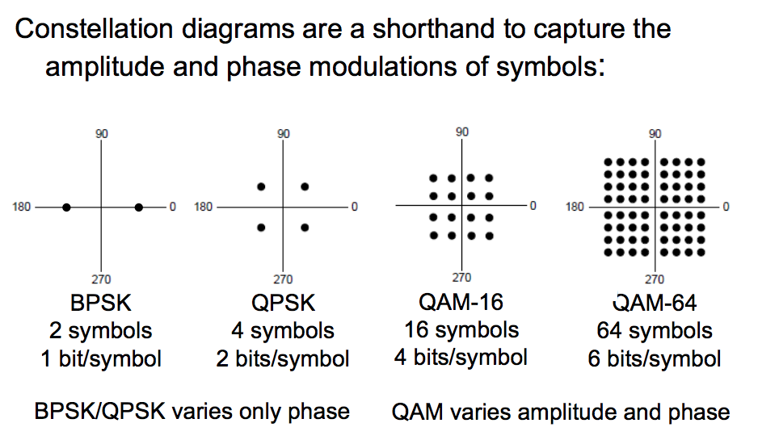
Constellation Diagrams

Slide 31
Question 12 (Modulation)
In a constellation diagram, all points lie on a circle centred on the origin. What kind of modulation is being used?
If all points are equidistant from the origin, they all have the same amplitude, so amplitude modulation is not being used.
Frequency modulation is never used in constellation diagrams.
So the encoding is pure phase-shift keying (PSK).
Binary phase-shift keying
Quadrature phase-shift keying

